Slide 1

DDoS Protection of the Europa websites
How to protect public websites from DDoS attacks
Florin BOTA (DG Digital Services)
Andrei PETROVICI (DG Digital Services)

Slide 2
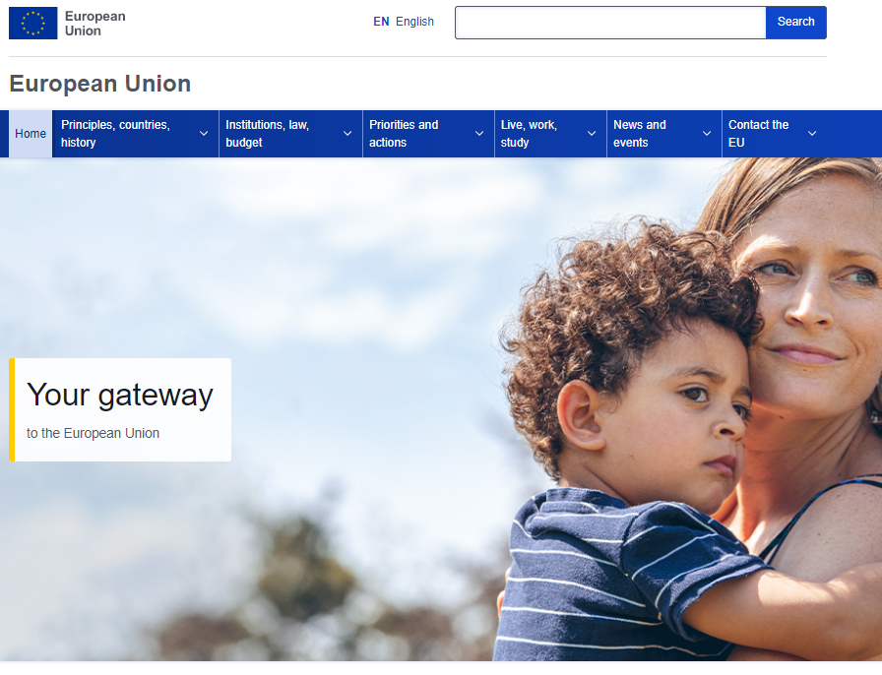
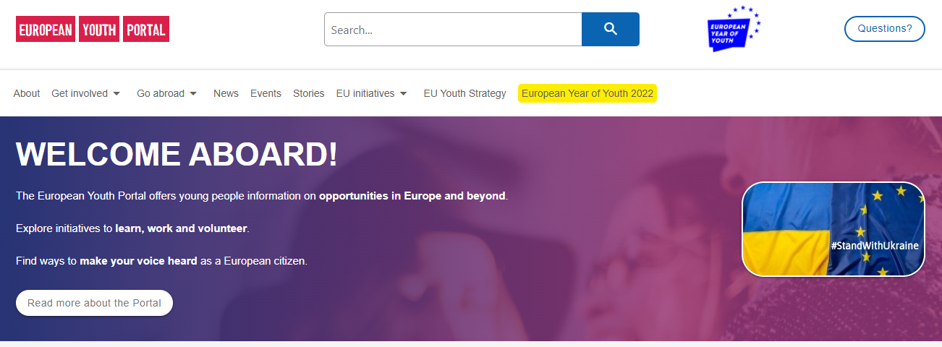
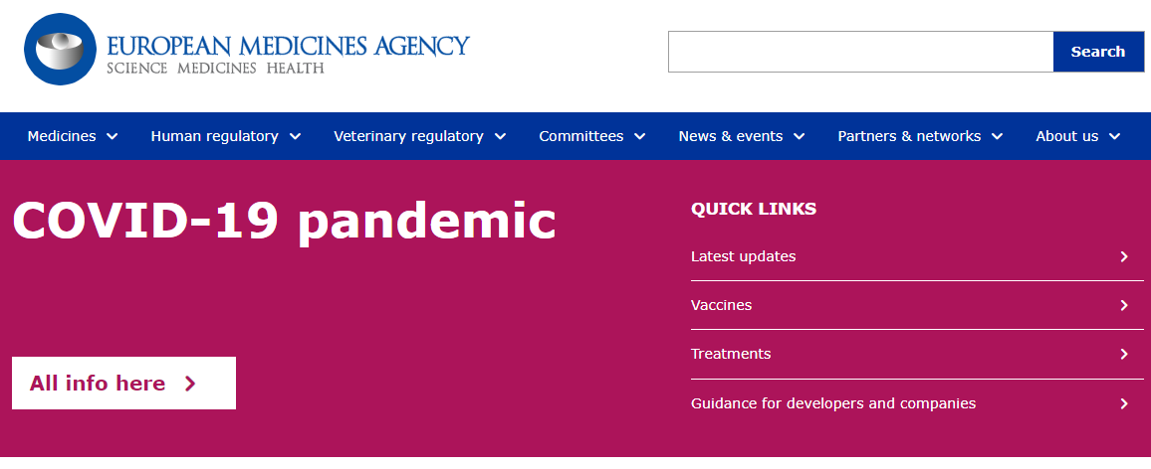




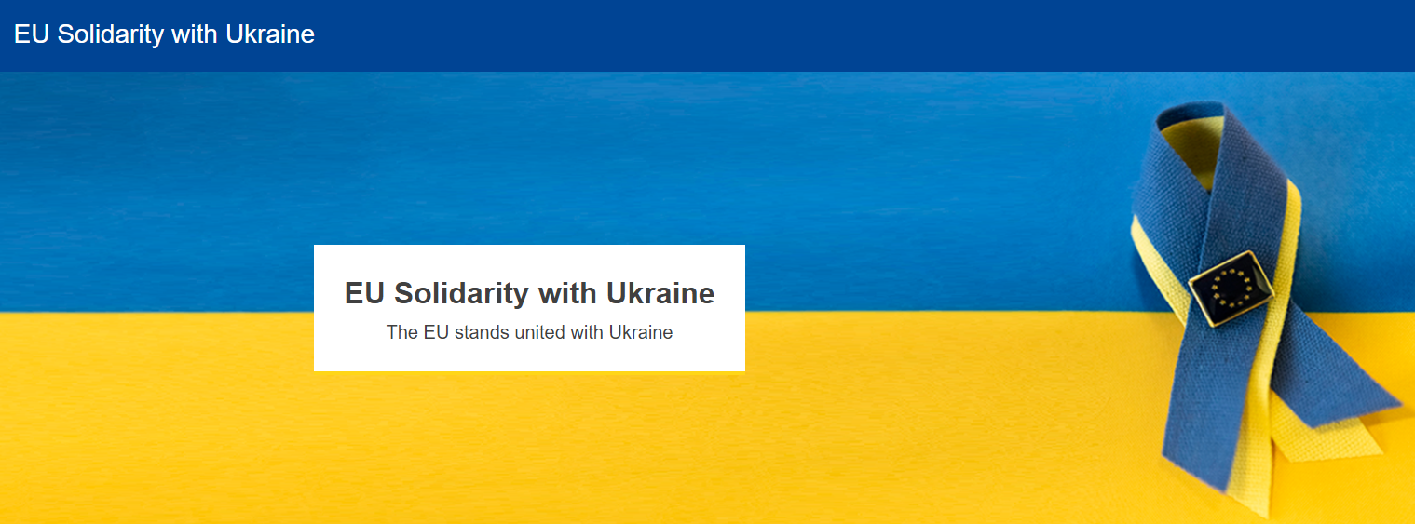



Agenda
EC Europa Drupal hosting service
Drupal Hosting Security
DDOS Protection of the Europa websites
DDoS identification
Lessons Learnt

Slide 3
EC Europa Drupal Hosting Service

Slide 4

EC Europa Drupal Hosting Service
Born out of the necessity to provide a fast, reliable and fully managed hosting solution for the public sites of the European Commission
Has grown from hosting a few European Commission sites to more than 300
Hosting also includes services like:
Vulnerability Management,
DDOS protection,
Compliance with Security rules
…

Slide 5
EC Europa Drupal Hosting Service
Supports any Drupal application with standard corporate architecture and managed CI/CD pipeline
330 sites supported with 295 in production
More than 140M HTTP requests/day
Dedicated First Level Support, QA, DevOps, and Security teams

Slide 6
Drupal Hosting Security

Slide 7
Drupal security measures in the Public cloud
EC Landing Zone
WAF & Shield Advanced
Logging, monitoring, intrusion detection
CSIRC and CERT-EU pre-alignment (« break the glass »)
Strong vulnerability management process
Use of 3rd party tools for vulnerabilities detection and security compliance

Slide 8
Europa DDOS Statistics
One year statistics:
CloudFront: more than 50 billion cached requests served
Varnish: 6 billion request blocked
Most attacked website (DDOS Level 7): European Commission main website
59% is bot generated traffic

Slide 9
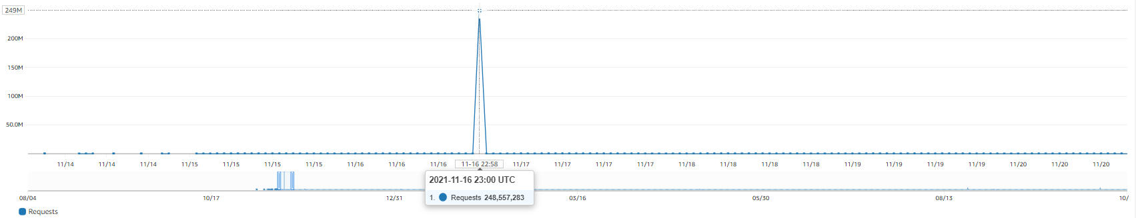

DDoS example
Main europa.eu site:
Very large DDOS: 249M requests/hour (regular 3 months of traffic)
No business impact -> blocked
Cost: ~250€ (requests, WAF, traffic)

Slide 10
DDOS Protection of the Europa websites

Slide 11
Drupal specific weak points
Generating full pages is “costly”
Generating + Searching = even more “costly”
Examples of “costly” pages: reports generated in real time, searches, processing of documents/videos
Cache: serves pages which were already generated (careful to TTL)
URL space:
Multiple URI paths (/search_en, /search_fr, /search_it …)
GET parameters are part of the URL since require separate caching

Slide 12
DDOS protection layers
AWS Advanced Shield
AWS Shield Response Team with proactive engagement
AWS WAF
IP reputation, known DDoS IPs, known bots and crawlers, blacklists …
Scalability
Cache and various rules (further details later)

Slide 13
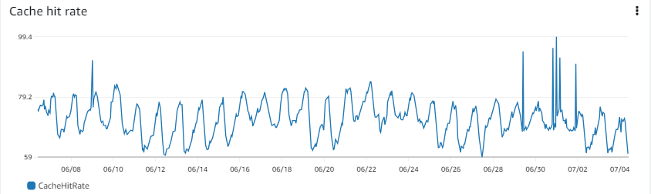
DDOS protection layers - Caching
CloudFront (CDN) -> ~50-70% hit with a 5 minute cache TTL
Lowers the number of distinct requests reaching Varnish
Automatic cache, geographically close to visitor (600+ Points of Presence)
Improves performance
Varnish cache -> longer TTL (8h), invalidated by drupal
Lowers the number of distinct requests reaching Drupal webservers
Caches URLs with info on dependencies (managed by drupal)
REDIS/Memcache -> application cache

Slide 14
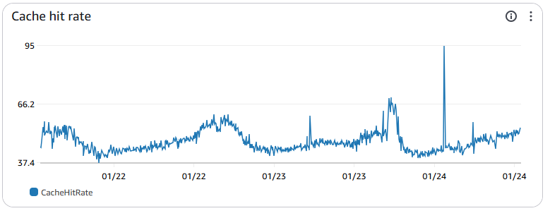
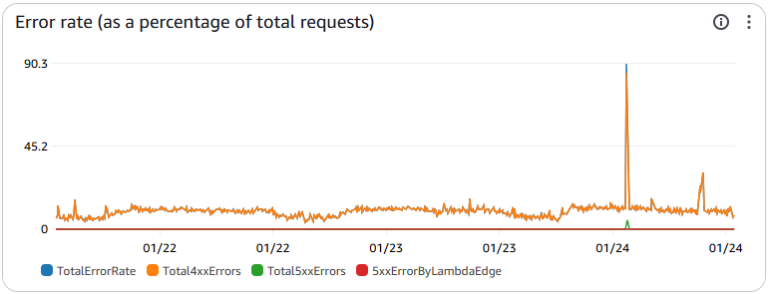
Cache hit ratio during DDOS
28.5M HTTP requests (Cloudfront)
64% cache hit ration on CDN (Cloudfront)
2.3M HTTP requests on Varnish (8.2% of CDN)
2.27M used Varnish cache
71 338 requests on webservers (3% of Varnish, e.g. 0.25% of CDN)

Slide 15
DDOS protection layers – caching protections
CloudFront
Break the glass policy (OLD): drop GET parameters for URIs – all requests of a site
Varnish
Custom DDOS blocking rules
Threshold rate limit for bots/crawlers
Break the glass policy (NEW): drop GET parameters – granularly per URL

Slide 16
DDOS protection layers – DDoS in Varnish
Bots/crawlers:
Rate limit block on number of requests for non-cached pages
DDoS -> Rate limit of requests with GET parameters for certain URI:
Whitelist cached content, requests from trusted networks or authenticated sources
Specific URI (regex – can include multiple languages)
Requests from a certain country or countries

Slide 17
DDoS identification

Slide 18
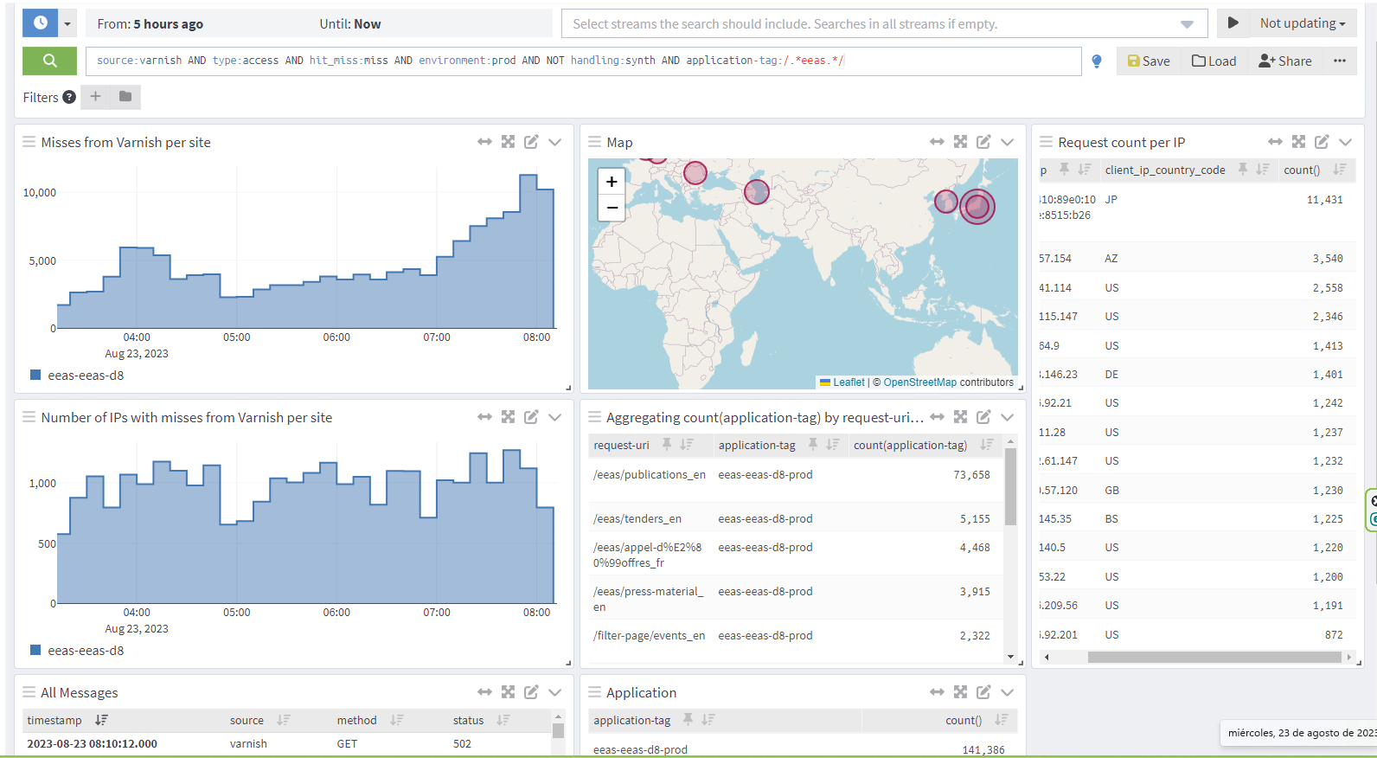

DDoS pattern - Graylog Dashboard

Slide 19
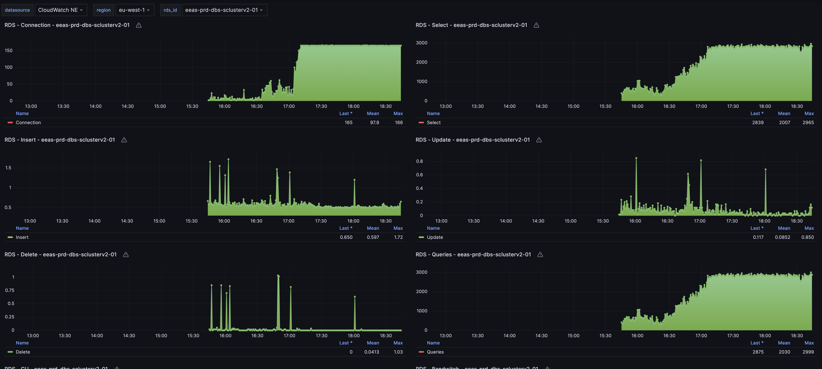
Impact of a DDoS

Slide 20
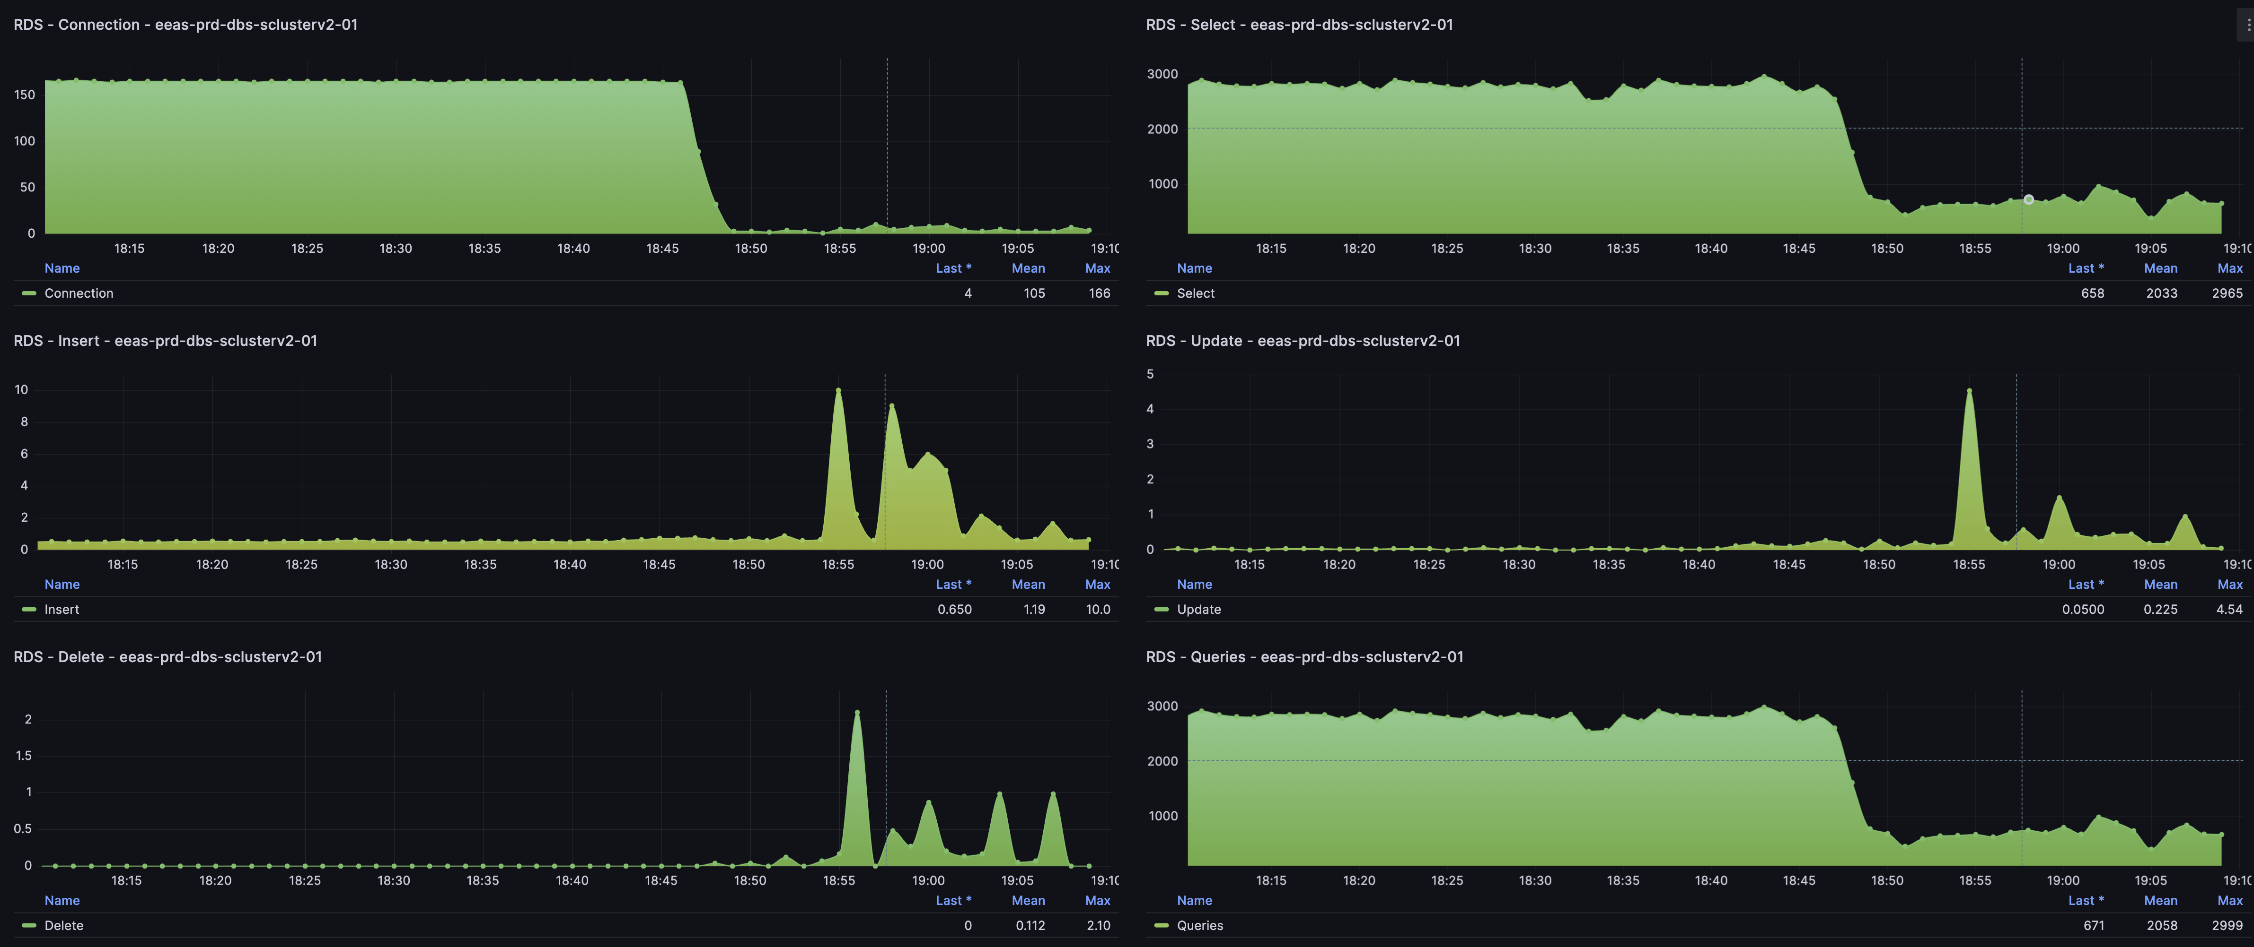
DDoS Impact mitigated

Slide 21
Bot and crawlers
High increment in AI crawlers – many undetected, AI teams not considering pressure/cost for sites crawled
Robots.txt -> many crawlers respect defined rules
Exclude from crawling search pages
Provide specific page with links to all desired content (no pagination, long cache TTL and no invalidation)
Content for AI and Data scientists:
Prepare set of exported data, machine readable format (API, XML, archive …)
Communicate rules on using content for such purposes (e.g. OK when using the archive, not allowed to crawl live site)
Custom User agents allowing clear identification of owner and purpose of bot

Slide 22
Lesson learnt
What is important? What can be improved?

Slide 23

Key Takeaways
Remember security: shared responsibility model
Security by design
Include WAF, DDoS protection, caching and scaling whenever possible
Prepare in advance with logging, monitoring and DDoS dashboards
Awareness and knowledge in the team
“Break the glass” policy to quickly address DDoS and minimize business impact
?

Slide 24
Questions?

Slide 25

Thank you
© European Union 2020
Unless otherwise noted the reuse of this presentation is authorised under the CC BY 4.0 license. For any use or reproduction of elements that are not owned by the EU, permission may need to be sought directly from the respective right holders.
Pictures on slides 8, 14, 15, 4 and 23 were generated by AI under CC0 1.0 Universal Public Domain Dedication, curtesy of DreamStudio Lite
Florin Bota
Florin-Mircea.BOTA@ec.europa.eu
Andrei Petrovici
Andrei.petrovici@ec.europa.eu

